Slide 1
Week 6 Performance I

Slide 2
Administrivia
Feedback for proposals sent out
Poster session shared with Intro to Vis class? Tues 4/28 6-8PM

Slide 3
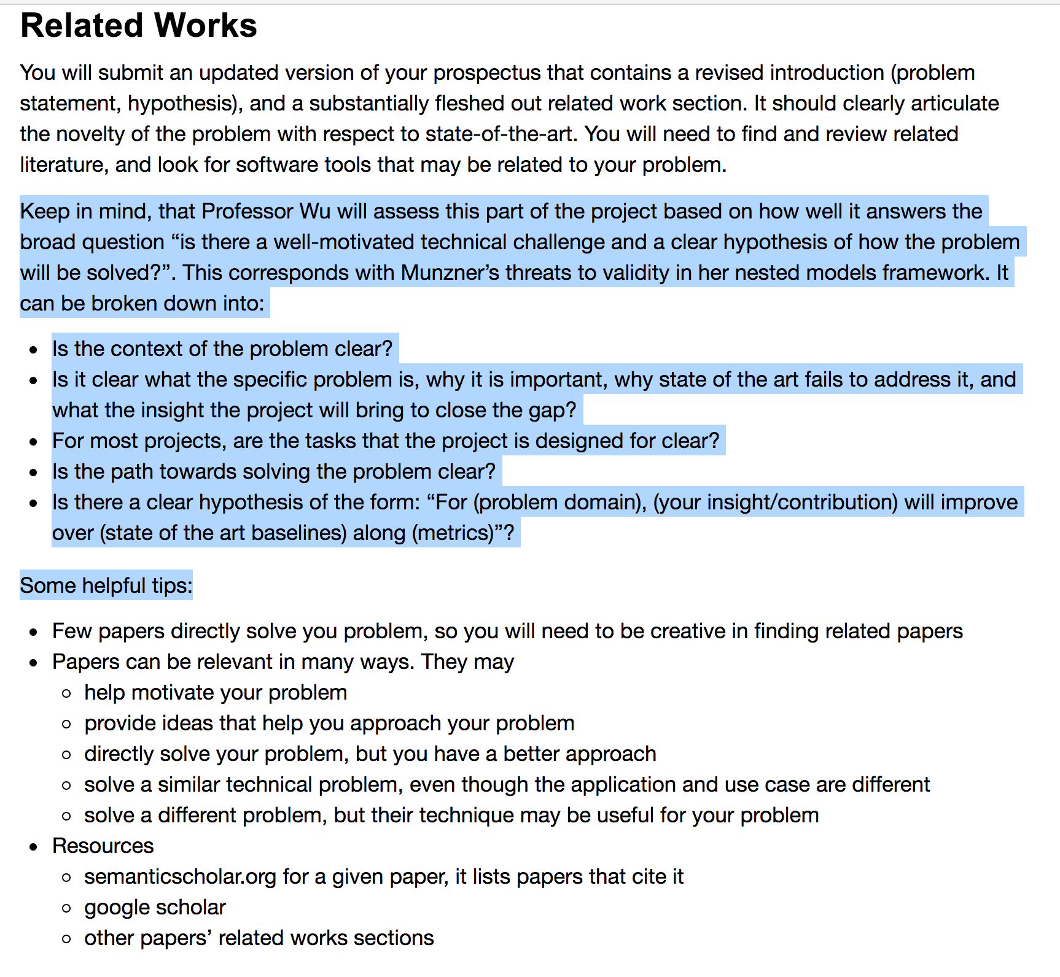

Slide 4
Administrivia
Immens
Presenter: Haneen
Scribe: Yiru Chen
Kyrix
Presenter: Yiru Chen
Scribe: Haneen

Slide 5
Immens Discussion

Slide 6
Contrast with Tableau
What was tableau’s vis-db architecture?
User interaction → SQL query → backend DB
How is immens different?
Precompute: know all interactions → SQL query → cubes
User interaction → cube lookup/compute

Slide 7
The writing
Who was the audience?
How did that affect what the paper focuses on?

Slide 8
Expressiveness
What class of SQL queries does Immens fundamentally express?
SELECT a1, [a2], count(*)
WHERE a3=? GROUP BY a1, [a2]

Slide 9
Core contribution
What “visualization level constraints” does immens use to motivate their use of data cubes?
binned visualizations
interaction dimensionality
plenty of “setup” time, visualization designs fixed
When are these constraints reasonable? not reasonable?

Slide 10
Applicability
When are the techniques (binning, cubing) not applicable?
arbitrary brushes
combinations of filters
arbitrary aggregates
zoom?
scatterplots with transparency (why?)
higher dimensionality interactions
b = 50 bins for each dimension
1d x 2d chart?
2d x 2d chart?

Slide 11
Space partitioning
Immens uses equi-width bins. Why? What’s an alternative?
sparse vs dense representations
lookups fast
sensitive to outliers in attribute values?

Slide 12
Kyrix Discussion

Slide 13
Expressiveness
What class of SQL queries does Kyrix fundamentally express?
SELECT * WHERE point WITHIN viewport
How general is this “zoomable UI” class of interfaces?
Why not Tableau?

Slide 14
Core contribution
“I have a big (legacy) DB, I have a design in mind. Help!”
Task oriented programming API for XUI
Minimum needed to “do the rest”
Layer only needs
SELECT * condition
how to position an item
how to render an item

Slide 15
Contrast with Immens
Immens: specific optimization. still need to build the app
Kyrix: task-specific API that handles the rest

Slide 16

imMens: Real-time Visual Querying of Big Data
Notes:
Today I am going to present imMens.
introduces techniques to scale-out interactions on visualization over large-scale data
https://columbiaviz.github.io/2020s_w6998/reviews/week6.html

Slide 17
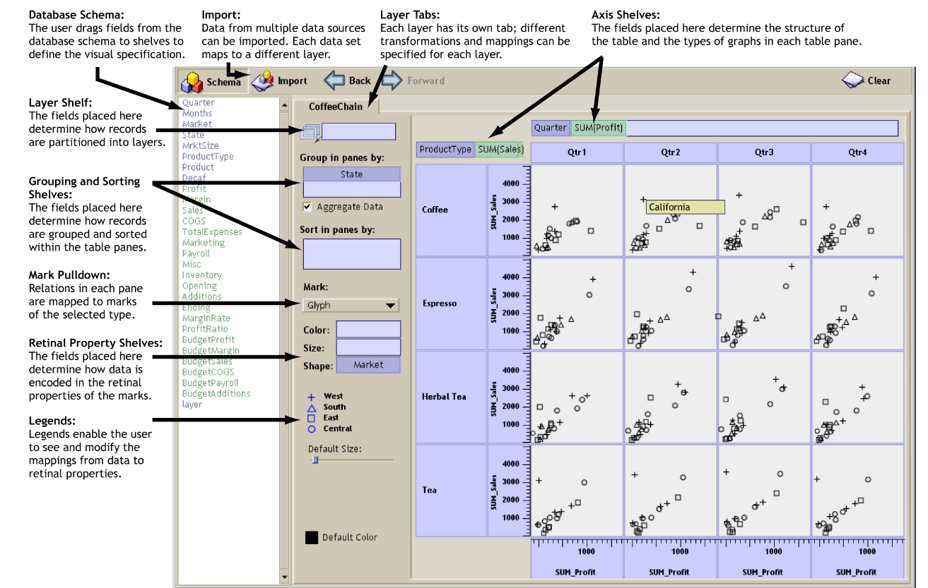
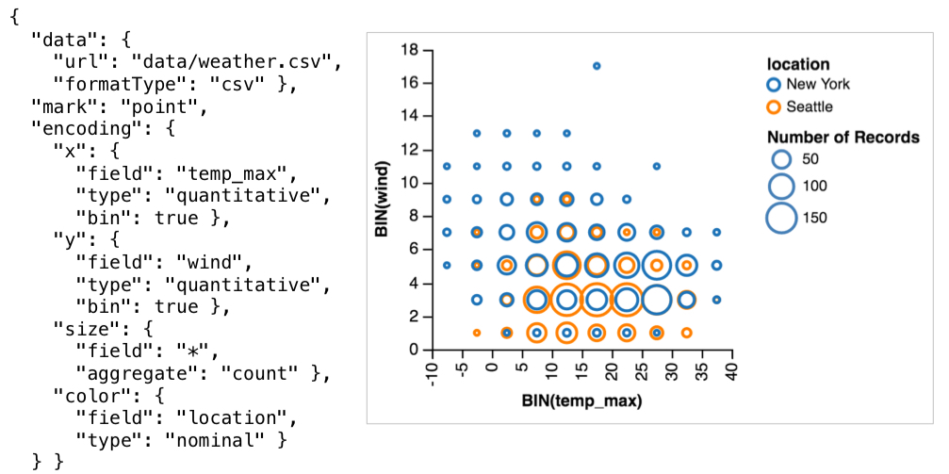
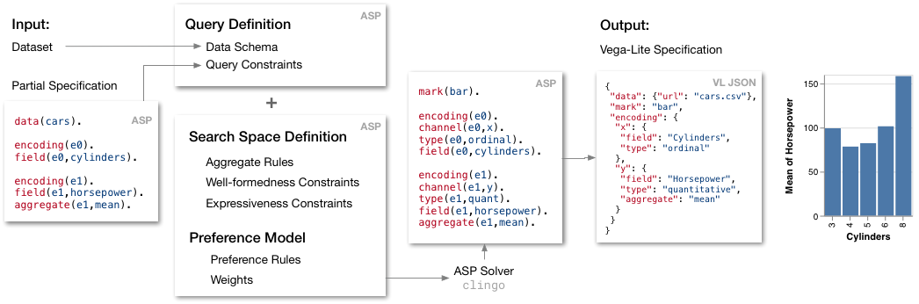
Motivation (1)
Notes:
So far we have explored
1- polaris:
2- vega-lite:
3- draco:
4: voyager:
These systems focused on how to construct visualizations, either by providing grammar of graphics, constraint based input, building recommendation engine that combine both to find the best set of visualizations that would facilitate data exploration.

Slide 18
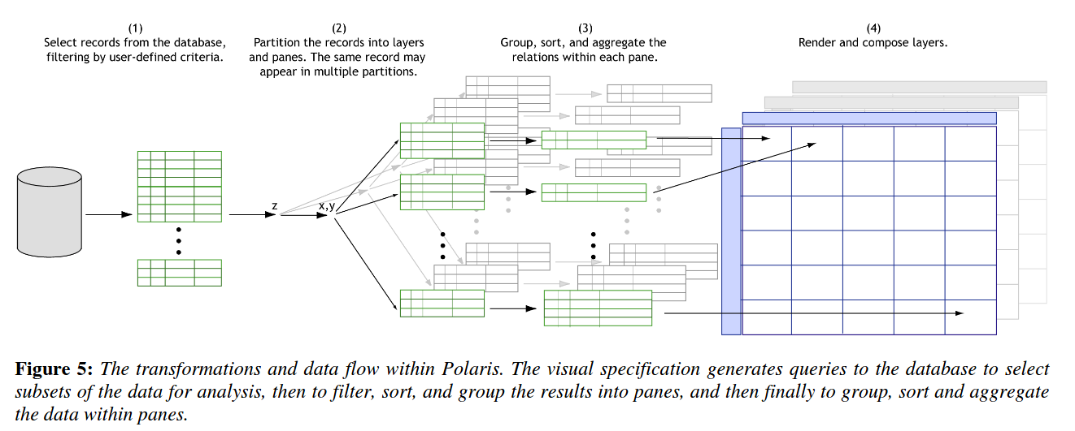
Motivation (2)
Notes:
We touched briefly last week with the Comparison paper on the issue of scalability.
In addition, we got a glimpse on how the backend is connected with the frontend in polaris.
Where the authors show different performance issues and they leave it for future work to address the interactivity and responsiveness of the system for large-scale data.
Today, we focus on the scalability problem and performance issue.

Slide 19
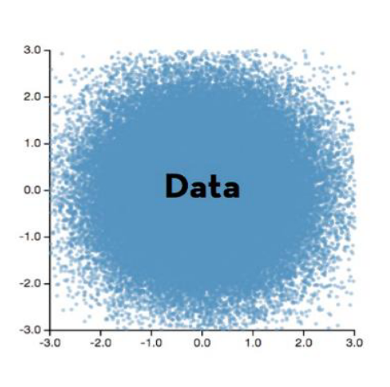
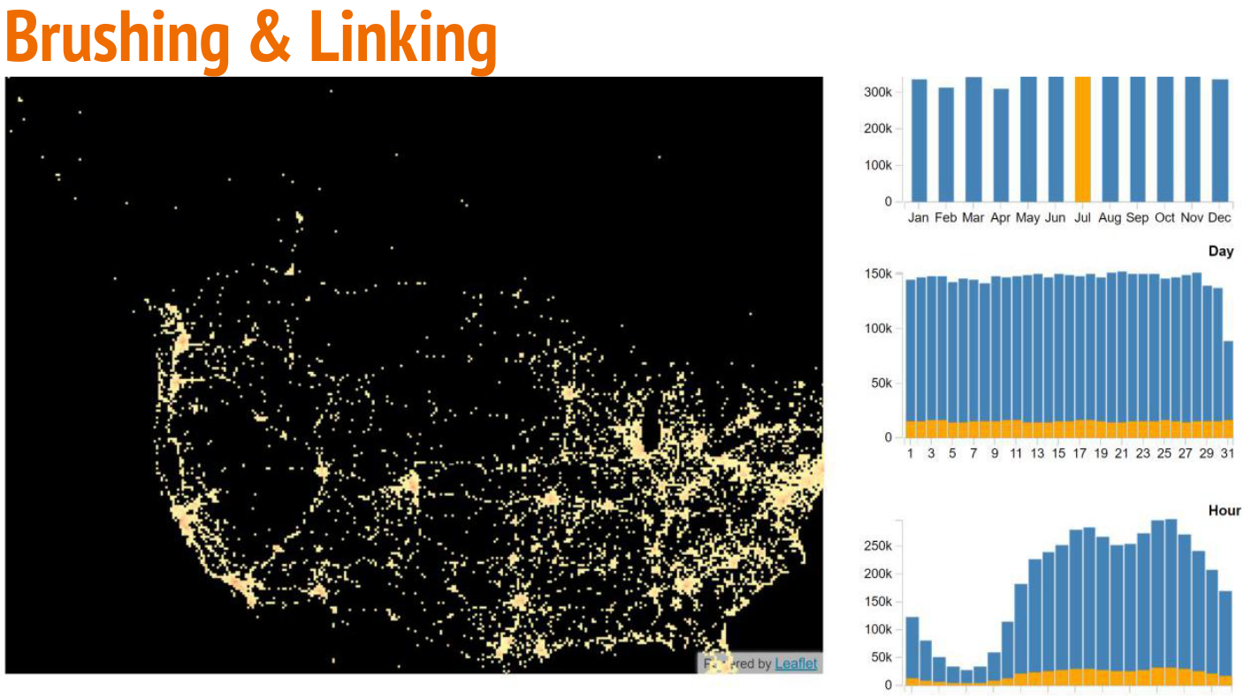

Challenges in Big Data Visualization
Perceptual scalability
Interactive scalability
SELECT month, count(*)
GROUP BY month
SELECT day, count(*)
WHERE month=Jul
GROUP BY day
Notes:
The paper focuses on two kinds of scalability: perceptual, and interactive
Which both occurs when a task has “too much” of something -> affect the user’s perceptual and cognitive limits
For example, Cluttered visualization can make it difficult to effectively draw insights from the data
A strategy provided last week in the comparison paper was to use : Select subset or Summarize somehow
That can be done by Adding interactions to explore the data
An example of interaction mechanism is Brushing and linking in which selections in one view highlight the corresponding data in the other views.
For example here: view (1) we compute number of records per month and view (2) computes them per day.
Selecting on July in view (1) would highlight the number of records in view (2) with month=July.
This requires computing aggregates filtered by selection which:
Does Not scale well with the dataset
If the data set doesn’t fit in-memory, it would require sending these queries to a server incurs latency due to both processing and networking delays

Slide 20
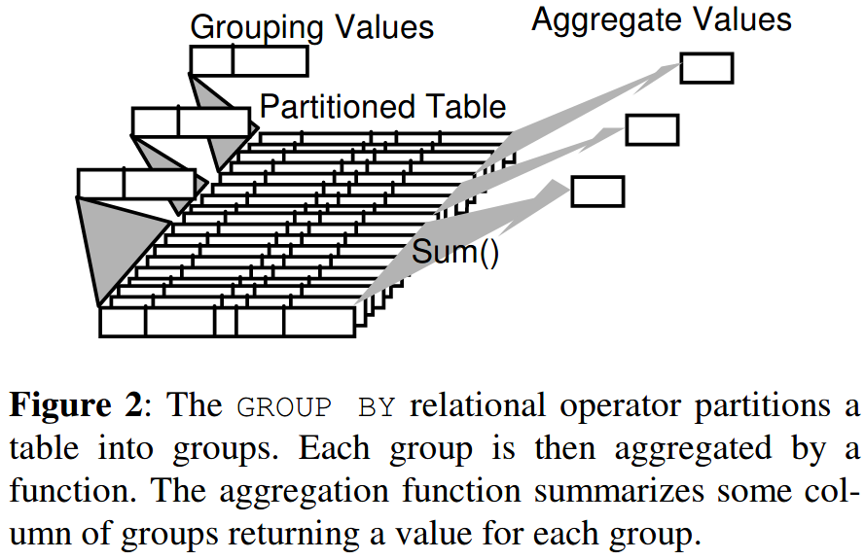
Group By Operation
SELECT month, count(*)
GROUP BY month
SELECT day, count(*)
WHERE month=Jul
GROUP BY day
Notes:
If we look into how the GROUP BY is computed, we can see that xxx
To accelerate that process we can precompute data ahead of time so these operations would mainly be lookup operations

Slide 21
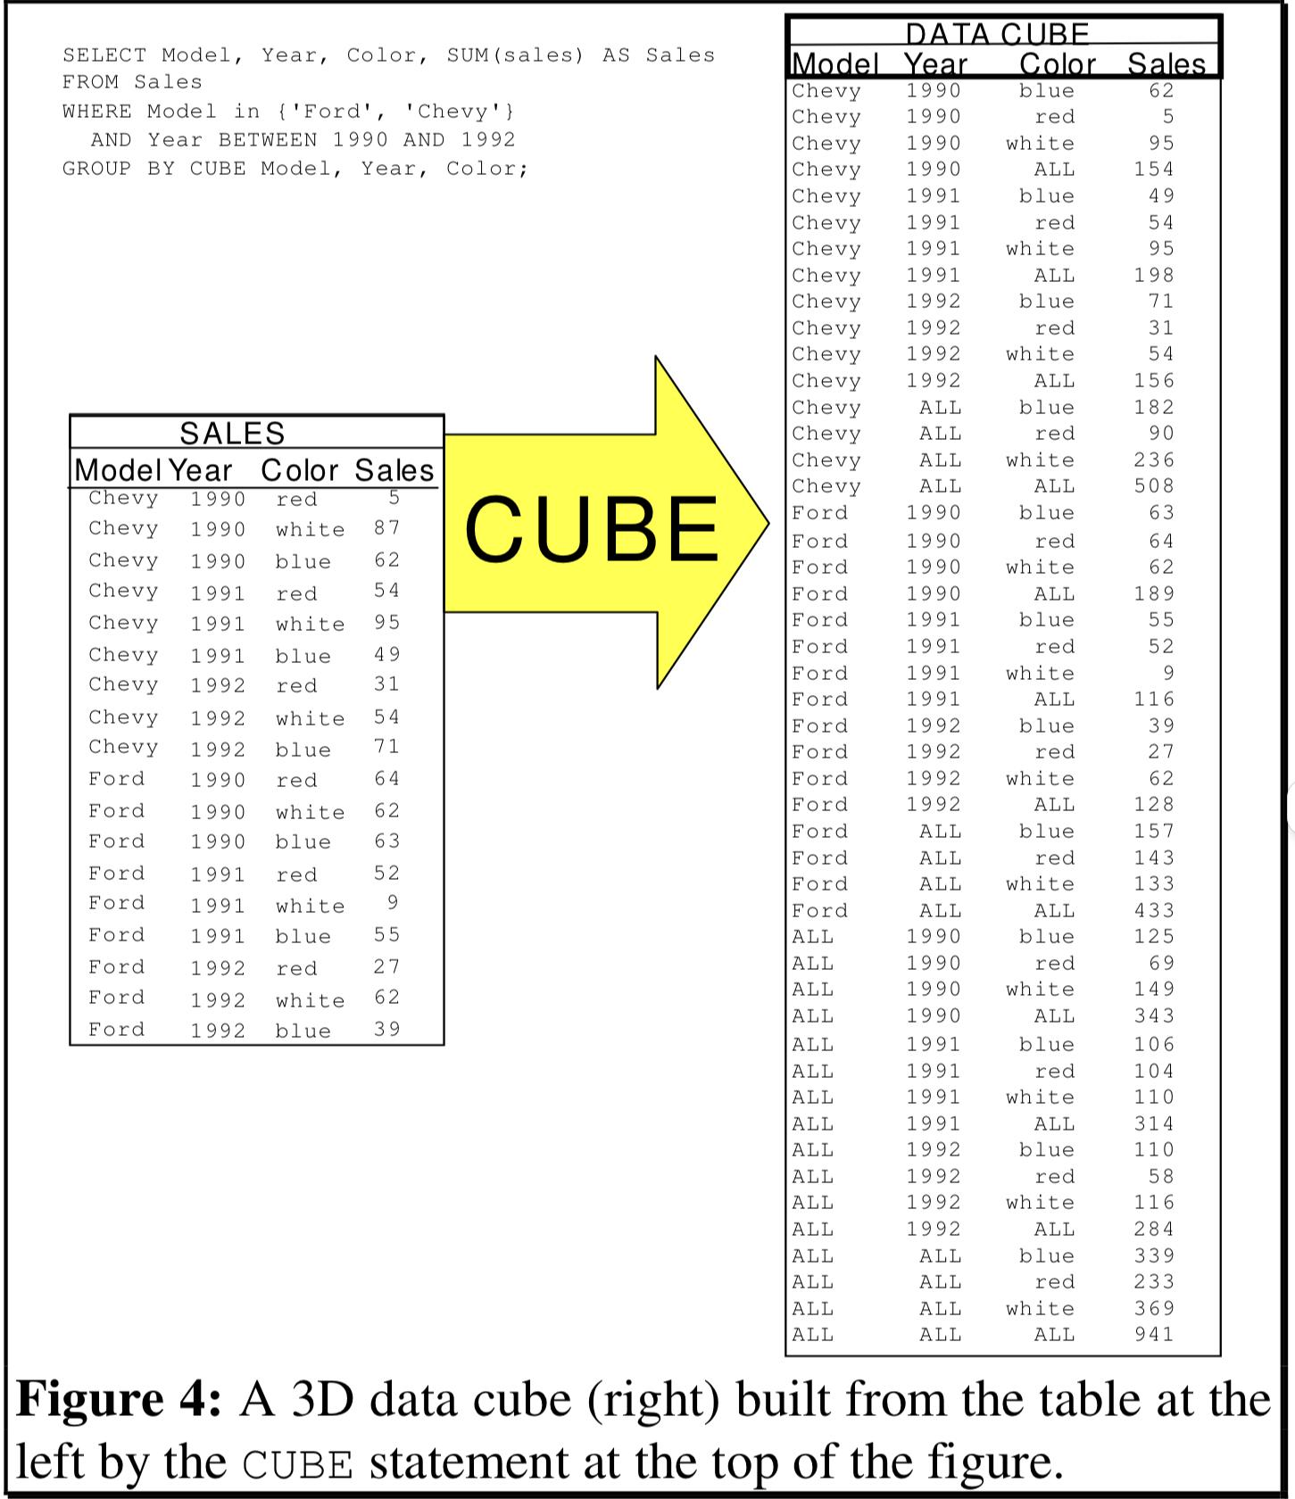
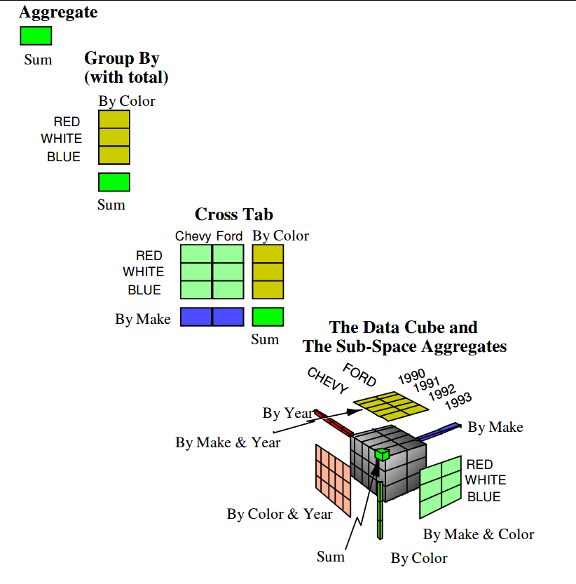
Data Cubes
Select color, SUM(sales) WHERE Model=Chevy and Year = 1992 GROUP BY color
roll-up
Notes:
The most common Data structure used to accelerate aggregation queries is data cubes.
The CUBE operation is the result of computing all possible GROUP BY aggregations for a given list of attributes (for n attributes 2^n group bys)
Although called a "cube", it can be 2-dimensional, 3-dimensional, or higher-dimensional.
Each dimension represents some attribute in the database and the cells in the data cube represent the measure of interest. For example, they could contain a count for the number of times that attribute combination occurs in the database, or the minimum, maximum, sum or average value of some attribute.
it precompute every possible aggregate query over the database to support quick exploration.
3*4*4=48
2^3 = 8 group bys
How does this help with interactions?
This size increases exponentially with the number of attributes and linearly with the cardinalities of those attributes.

Slide 22
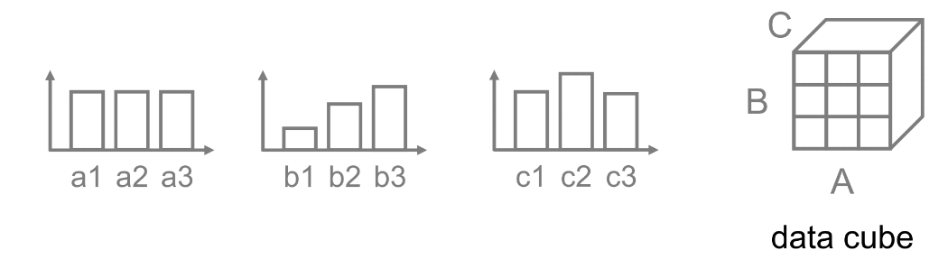
Example
SELECT A, count(*) GROUP BY A
SELECT B, count(*) GROUP BY B
SELECT C, count(*) GROUP BY C
Notes:
As a small example: here we have 3 linked visualizations
Each represent a group by on an attribute the the number of counts of that attribute

Slide 23
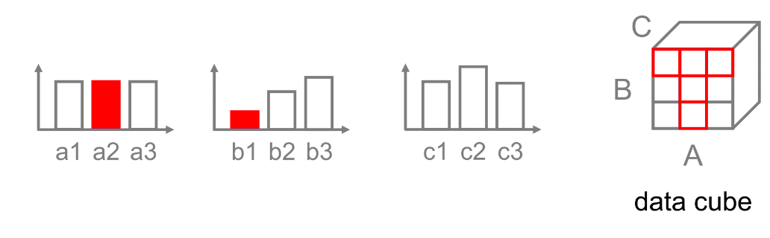
Example
SELECT A, count(*) GROUP BY A
SELECT B, count(*) GROUP BY B
SELECT C, count(*) WHERE A=a2 AND B=b1 GROUP BY C

Slide 24
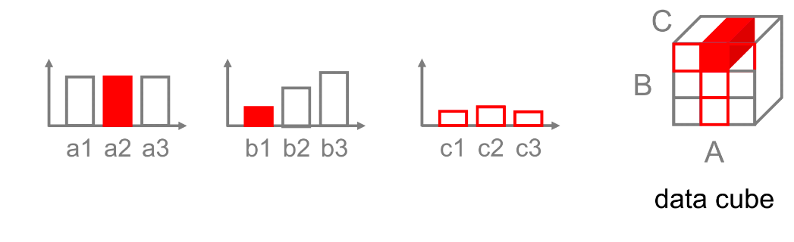
Example
SELECT A, count(*) GROUP BY A
SELECT B, count(*) GROUP BY B
SELECT C, count(*) WHERE A=a2 AND B=b1 GROUP BY C

Slide 25
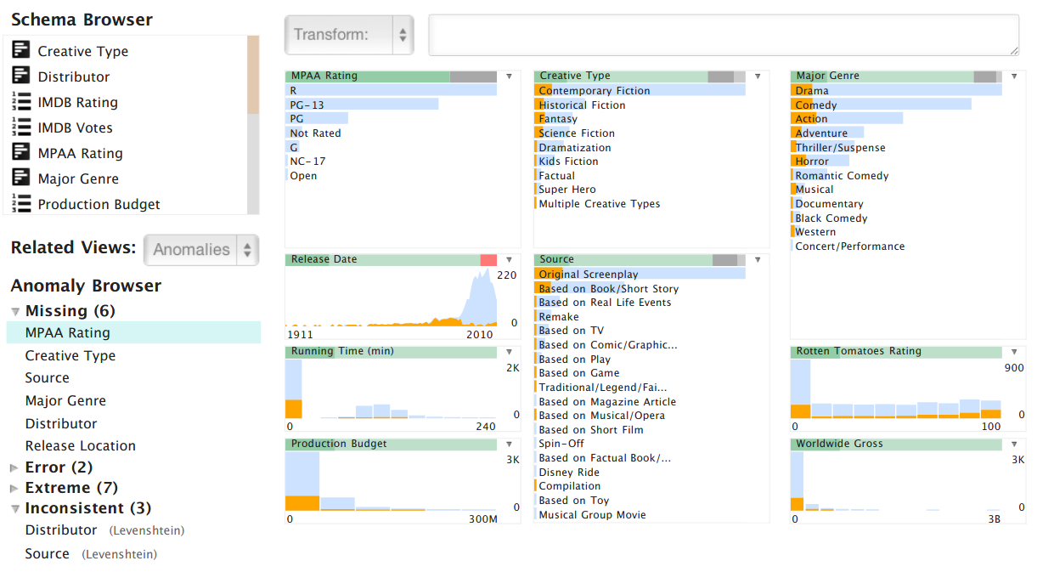
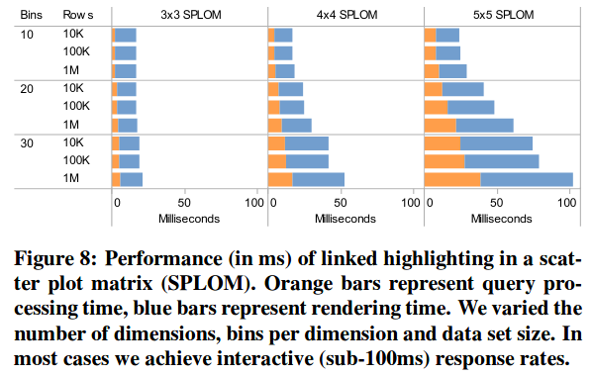
Related Work: Profiler
Notes:
http://vis.stanford.edu/files/2012-Profiler-AVI.pdf
http://users.eecs.northwestern.edu/~choudhar/Publications/InfrastructureForScalableParallelMultidimensionalAnalysis.pdf
Profiler, a visual analysis tool for assessing quality issues in tabular data.
It uses binned plots to accelerate interactions
Uses a single in-memory data cube and sequential query processing to support brushing & linking → doesn’t scale to larger data sets

Slide 26
imMens Contributions
Guide: Scalability should be limited by the chosen resolution of the visualized data not number of records
Notes:
Scalability should be limited by the chosen resolution of the visualized data not number of records
-> Immens: browser-based system for real time interaction with scalable visual summaries of big data

Slide 27
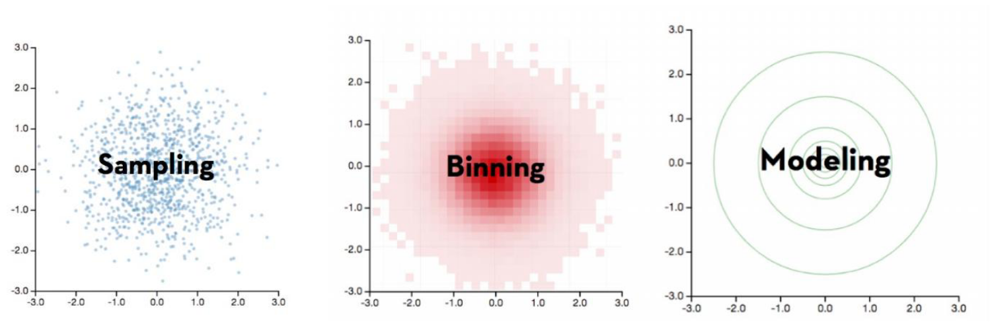
Data Reduction Methods
Filtering & Sampling (Select subset)
Uniform Sample: data might not be representative
Binned aggregation
Model-based Abstraction (Summarize somehow)
Hybrid Reduction Methods
Notes:
The paper dedicates a whole section on data reduction methods, which felt repetitive at first especially that most of the techniques mentioned was already mentioned in the related work.
They used it to justify their reduction method choice
Data reduction methods aim to reduce visual clutter
the process of hiding detail of data while maintaining the important characteristics of data
Techniques for data abstractions:
Filtering, Sampling: uniform, stratified, systematic sampling
Requires specific dimensions be chosen ahead of time, requiring prior knowledge and often costly pre-processing
Binned aggregation: aggregates data and visualizes density by counting the number of data points falling within each predefined bin.
Model-based: describe data in terms of mathematical models or statistical summaries -> contours
Hybrid: filter + model, sampling + aggregation
Comparison: Strategies listed in the comparison paper:
Scan sequentially, Select subset, Summarize somehow

Slide 28
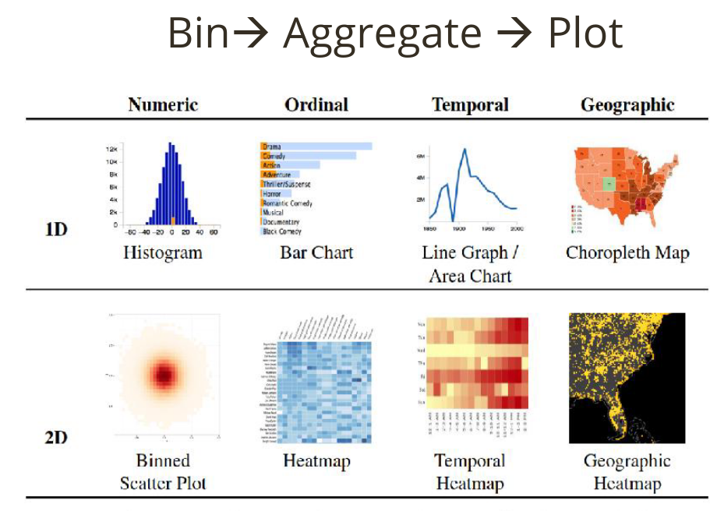
Notes:
This paper focused on binned aggregation as the primary data reduction strategy
Why:
Global patterns (densities)
Local features (outliers)
Multiple level of resolution by controling bin size
Binning schemes for four data types: ordinal, numeric, temporal and geographic
This show a design space of binned plots for supported data types
They focus on binned plots up to two data dimensions
Color used to encode data density

Slide 29
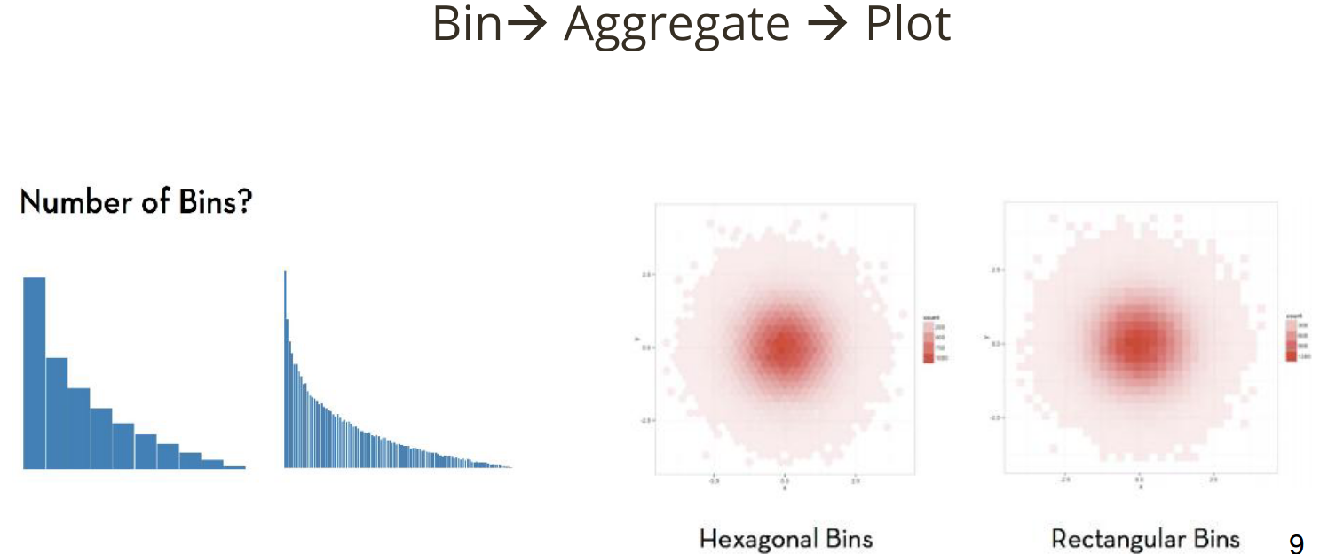
Notes:
They treat bin count as an adjustable parameter bounded by the screen pixels
They don’t go into details on how the bins are chosen
Although Constrained by texture size: 256 bins per dimension for 3D data and 64 bins per dimension for a 4D tile

Slide 30
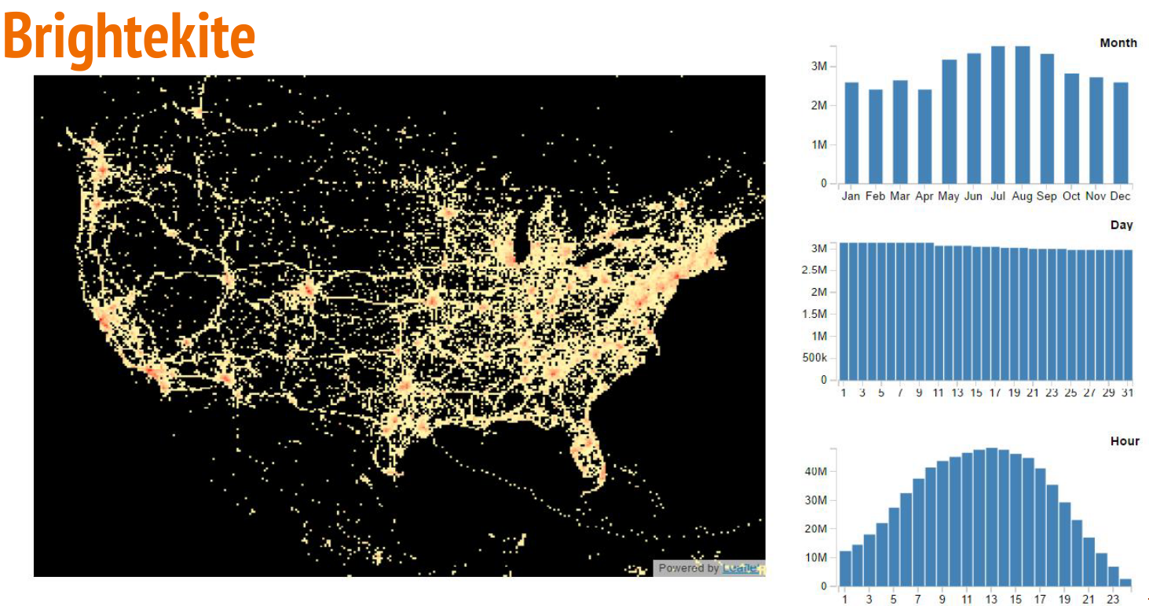
Challenge: Real-time interaction
Notes:
The paper addressed the first challenge which is perceptual scalability using binned aggregations.
The second challenge the paper focus on is interaction scalability.
The paper uses this set of visualizations as a running example.
5D: User, Date, Time, Lat, Long
Four linked visualization

Slide 31
Challenge: Real-time interaction
Notes:
Brushing and linking in which selections in one view highlight the corresponding data in the other views
This requires computing aggregates filtered by an initial data selection
The Jan bin is selected in the Month histogram in response the corresponding data are highlighted in orange in the other histograms
The map shows only the checkins in the month of Jan

Slide 32
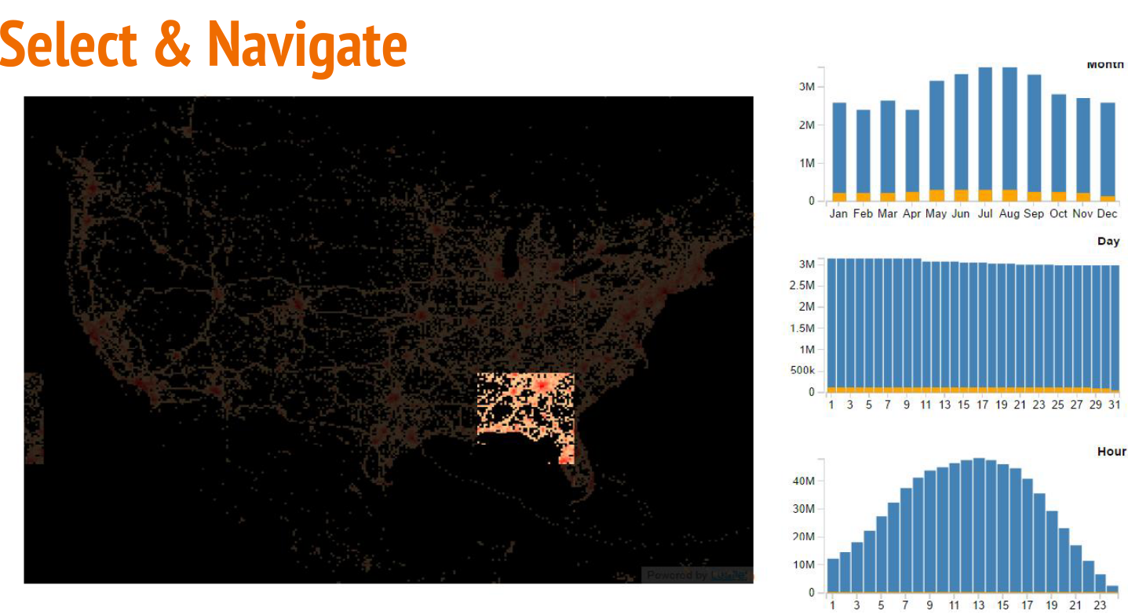
Challenge: Real-time interaction
Notes:
Select & navigate

Slide 33
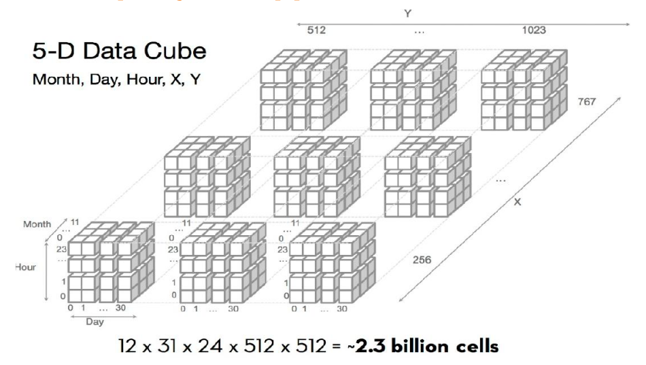
Real-time interaction
Notes:
If we use data cubes over (X, Y, Month, Data, Hour) -> 5-dimensional data cube

Slide 34
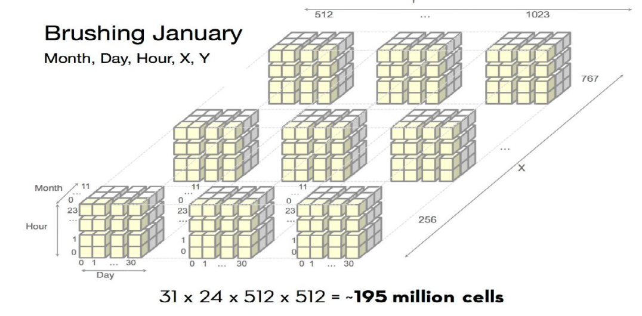
Real-time interaction
Notes:
To perform brushing and linking from the Month histogram we can filter the data cube to only the rows with bin 0 in the month dimension
And perform a roll-up by summing data along the Hour, X, and Y dimensions.

Slide 35
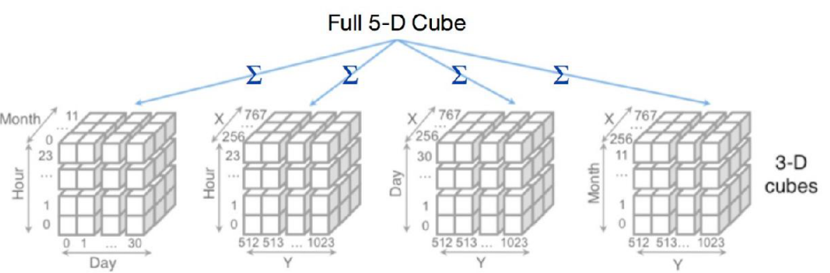
Real-time interaction
512*512*12*24*32=2,415,919,104 = 2.4B
(512*512*24)+(512*512*32)+(512*512*12)+(31*24*12) = 17,834,720 = 17.8M
Notes:
A major draw back with the full data cube is that the size can be large that it can’t fit in memory .
As the number of bins or dimensions increases the data cube size increase.
The paper address this issue by recognising that the user doesn’t express all combinations,
The main idea: decomposing full data cube and Build cube for pairs of plots
Four 3-dimensional cubes can cover all the possible brushing and linking scenarios
(X, Y, Hour), (X, Y, Day), (X, Y, Month), (Hour, Day, Month)
(512*512*24)+(512*512*32)+(512*512*12)+(31*24*12) = 17834720
512*512*12*24*32=2415919104

Slide 36
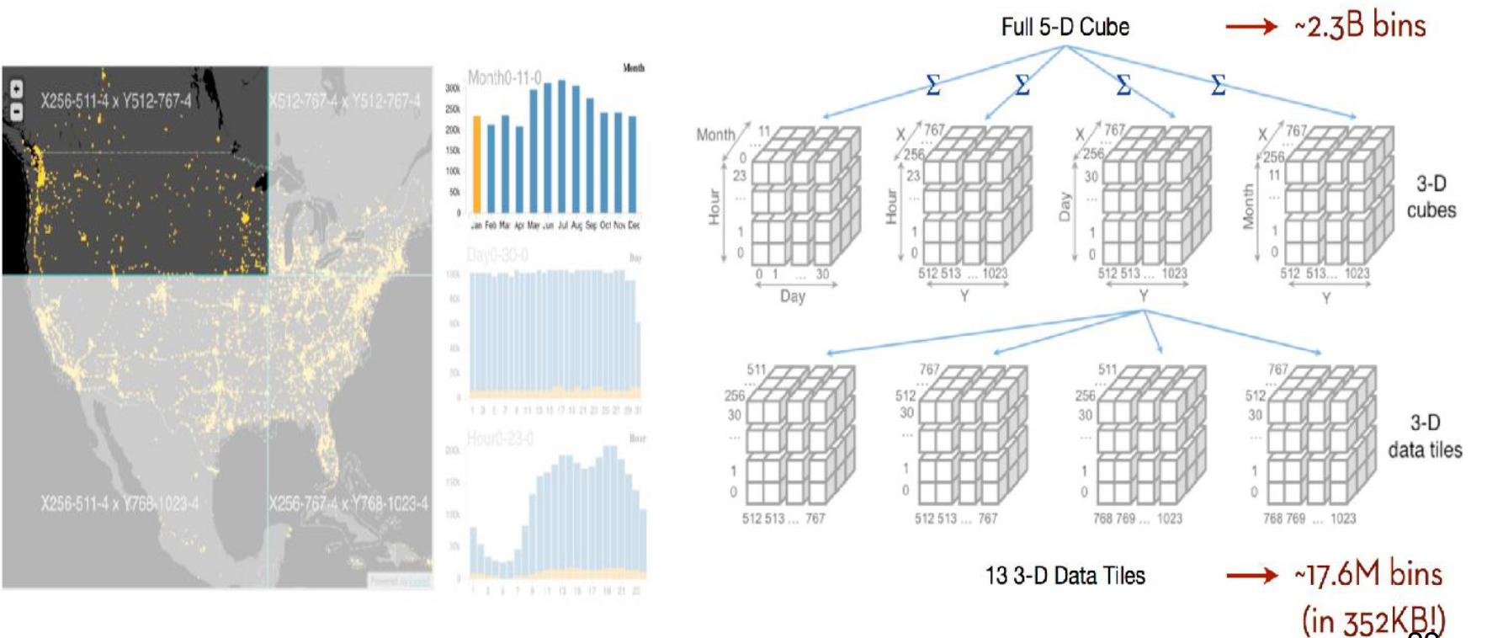
Real-time interaction
512*512*12*24*32=2,415,919,104 = 2.4B
(512*512*24)+(512*512*32)+(512*512*12)+(31*24*12) = 17,834,720 = 17.8M
Notes:
To handle large bin counts they segment the bin ranges to form multivariate data tiles
They are precomputed on a server and then loaded on demand to support client-size visualization

Slide 37
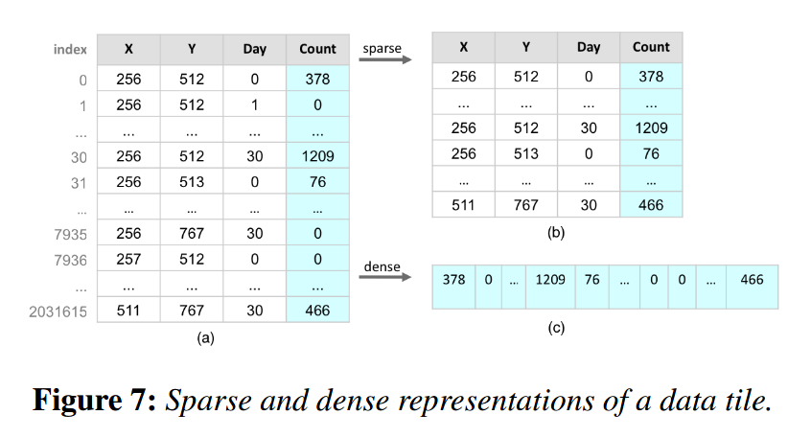
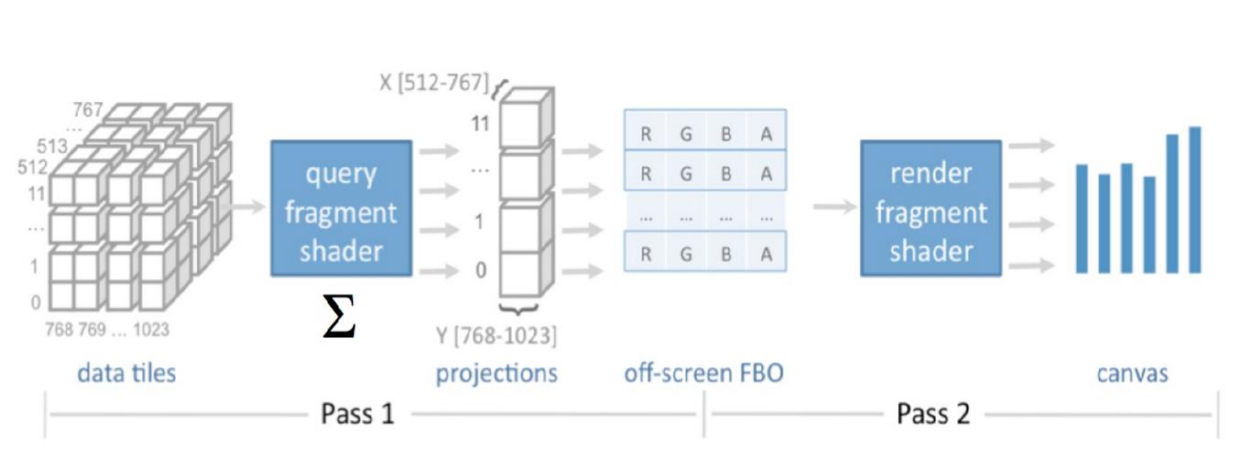
Parallel query processing
Dense vs Sparse
Packing data into an image format
Utilize GPU processing to compute roll-up operations
Notes:
Dense vs Sparse representation
They choose dense because is it simple, efficient to perform parallel processing when aggregating data tiles.
Consistent indexing scheme
Image tiles
Packing data into an image format -> directly bind them to the WebGL
Efficient storage and transfer of tiles
Easy to use with GPU
Constrained by texture size: 256 bins per dimension for 3D data and 64 bins per dimension for a 4D tile
Processing on GPU:
They utilise GPU processing the compute roll-up operations
For all bins, perform aggregation in parallel

Slide 38
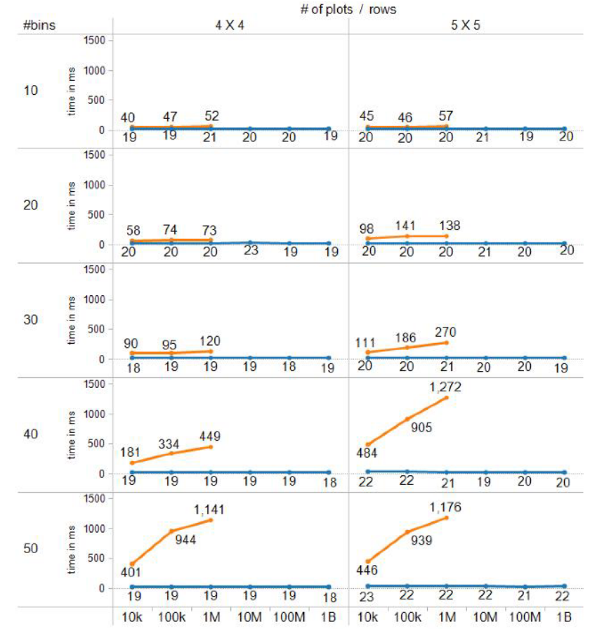
Evaluation
Guide: Scalability should be limited by the chosen resolution of the visualized data not number of records
imMens sustains an average 50 fps across all conditions -> invariant to the original data set size
Notes:
They measure system frame-rate during brushing & linking ->
measure time it takes to compute roll-up query and rerender the display
Vary:
Per dimension bin count
Number of dimensions
Number of input records
Due to memory limit, profiler can not visualize data with more than 1M
imMens sustains an average 50 fps across all conditions -> invariant to the original data set size

Slide 39
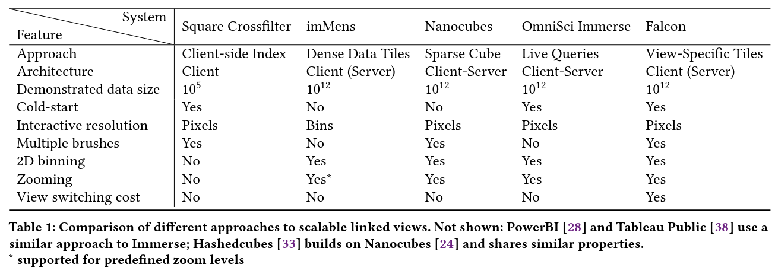
Future Work
Data Cubes Variants:
2013
2013
2013
2016
2019
Notes:
follow up works:
Does immens only support one active filter at a time?
“imMens [27] uses precomputed summaries to enable real-time interactions in the browser, butt heir interactions are limited to the binning resolution and a single interactive brush”

Slide 40
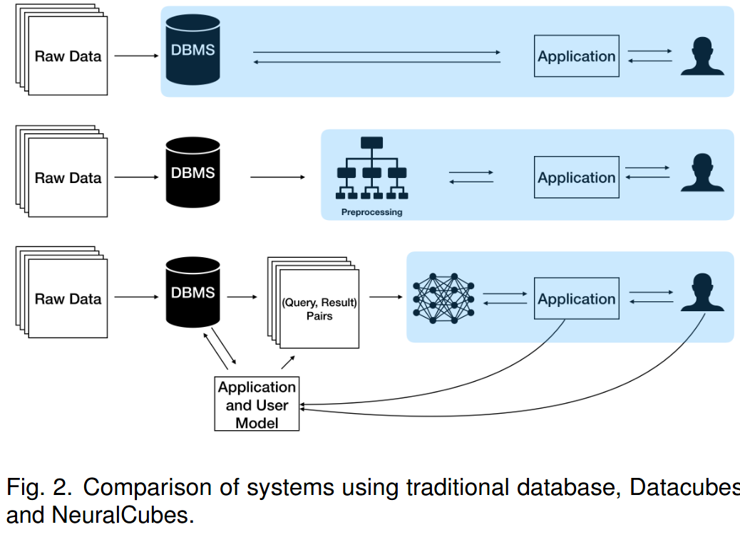
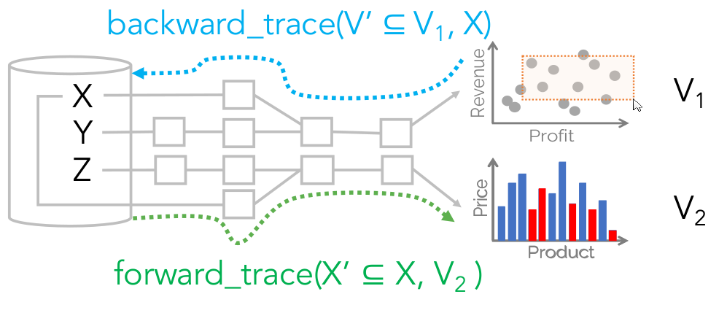
Future Work
SMOKE: avoid computing data cubes and use provenance to answer forward and backward queries
Neuronal Cubes: learns a function that takes as input a given query and outputs the result of the query
Some combination of: Sampling & Progressive Results + Materialized Views + Prefetching &Caching
Smoke
Neuronal Cubes
Notes:
What could be follow up works? EXAMPLE
What ideas came to mind as you researched the paper?
If the paper is not recent, what ended up being follow up works (from same or different groups)?
https://arxiv.org/pdf/1808.08983.pdf

Slide 41
Discussion
Notes:
Lack of support for ad-hoc compound brushing of more than 4D? Do we need more?
How long does it take to compute data tiles?
What happens if the base table is not static?
How expressive/effective is binned aggregation?
Use sampling to accelerate tile computations and prefetch data to client perform it is requested
Does immens only support one active filter at a time?
“imMens [27] uses precomputed summaries to enable real-time interactions in the browser, butt heir interactions are limited to the binning resolution and a single interactive brush”

Slide 42
Kyrix: Interactive Pan/Zoom Visualizations at Scale
Presenter: Yiru Chen

Slide 43
Motivation/Intro
Pan and zoom are powerful interaction techniques.
Nowadays, we can not assume data can fit in memory.
Although specialized systems, like google map, can zoom/pan well at scale, general-purposed systems still lack the backend support and data primitives that are necessary for large-scale visualizations.

Slide 44
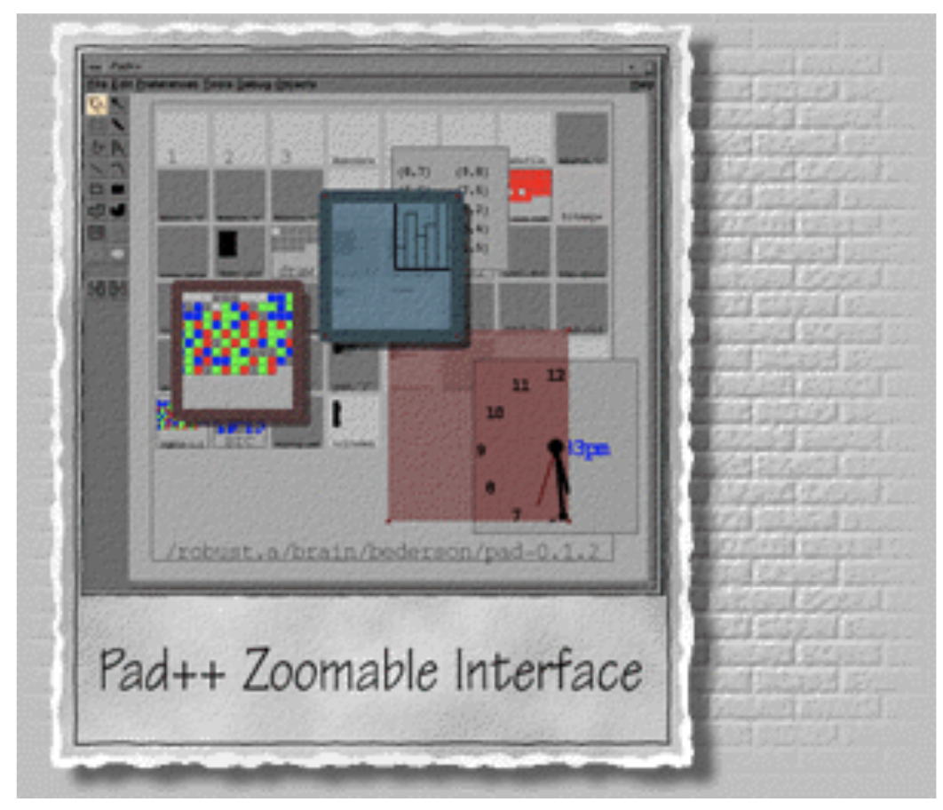
Related Work
ZUI toolkits:
1997 pad++
2015 ZVTM ….
Lack scalability
Lack data driven primitives

Slide 45
Related Work
Optimization:
Image tile
Caching
Prefetching, ..
Declarative language has been proven to be successful in defining visual analysis task.
VEGA, VizQL..

Slide 46
Contributions
A general zoom/pan tool that provides
Data driven primitive language
Easy to use
Support backend database optimization
Scale up to 100 millions data points
Bounded reponse time

Slide 47
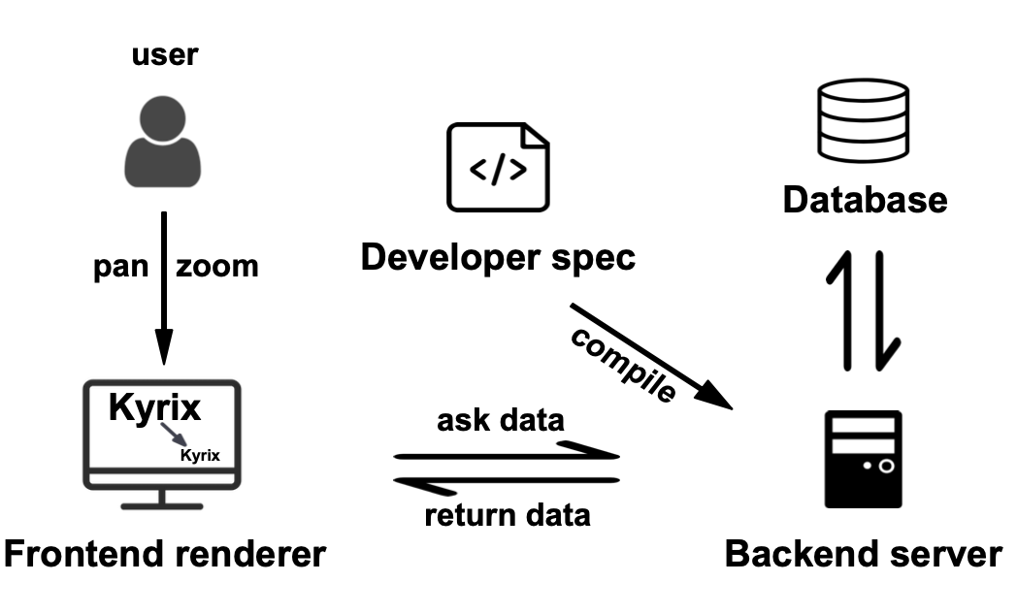
Contributions 1 – Generality
Support for general data types and visualizations
Notes:
On the developer side, we offer a declarative model for specification of pan/zoom visualizations.
//Declarative designs hide execution details (e.g. backend optimization and frontend rendering) from the developer, so that they can focus on visual specification.
On the execution side, the compiler parses the developer’s specification and performs basic constraint checking. Based on the specification, the backend server then precomputes necessary database indexes for performance optimizations.
The frontend renderer is responsible for listening to user activities, communicating with the backend server to fetch data and rendering the visualizations.

Slide 48

Notes:
Let’s watch an example of how zoom and pan works.
iN this video, when zoom in, the canvas changed,

Slide 49
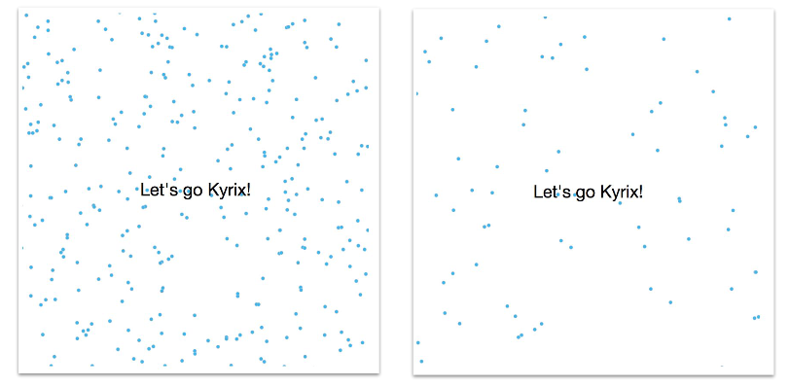
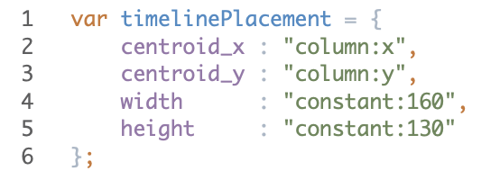
Contributions 2 – Data driven primitive language
Canvas
Dynamic --- have placement function
Static
Zoom
From a source to a destination canvas
continuous geometric zoom on one canvas
Selector - custom selection of visual objects that can trigger a zoom.
Viewport - the viewport location after the zoom.
Transform
prepares the data source for rendering a layer
Placement function
calculates a spatial information of objects on canvas
Enable fast fetching
Notes:
From the video we have watched, it is naturaly to define the concept of canvas and layer.
The layer concept in our model is conceptually analogous to the layer operator proposed in existing visual specification grammars

Slide 50
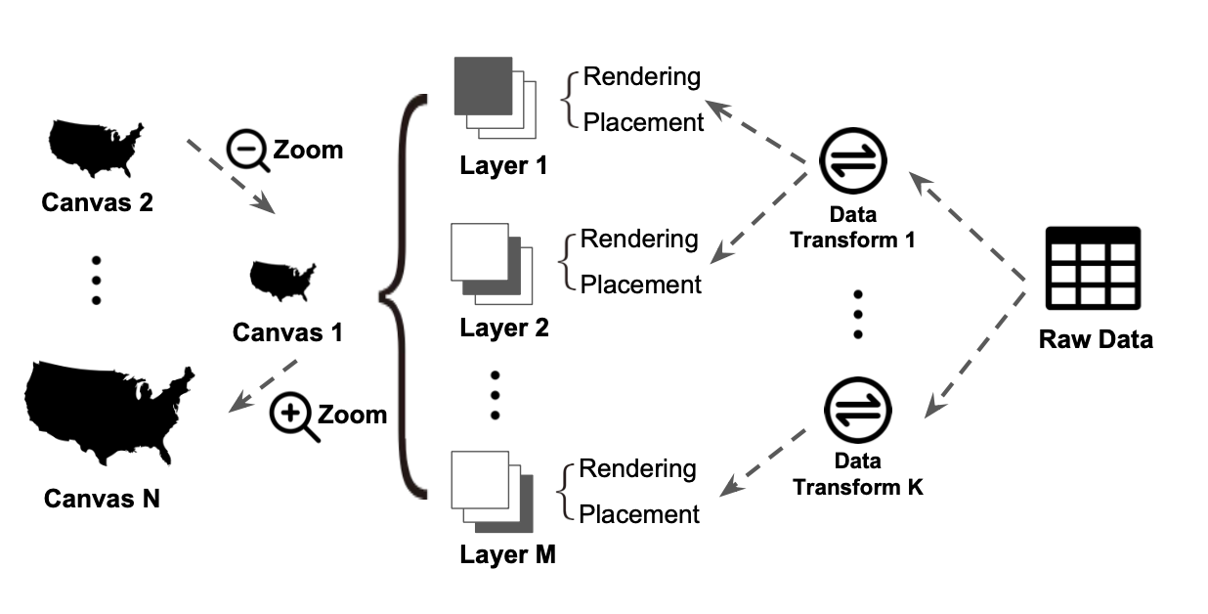
Contributions 2 – Data driven primitive language
Overall Declarative Model
Notes:
Canvases are “zoom levels” connected by zooms.
A canvas has multiple layers.
A data prepares the data source for rendering a layer. A rendering function maps data to visual objects. A placement function provides spatial information of objects to enable fast data fetching.

Slide 51
Contributions 3 – Performance Optimization
How to only fetch visual objects falling into the viewport as the viewport is frequently changed by pan/zoom interactions?
Consideration:
Memory size, the cost of look up (CPU, bandwidth )

Slide 52
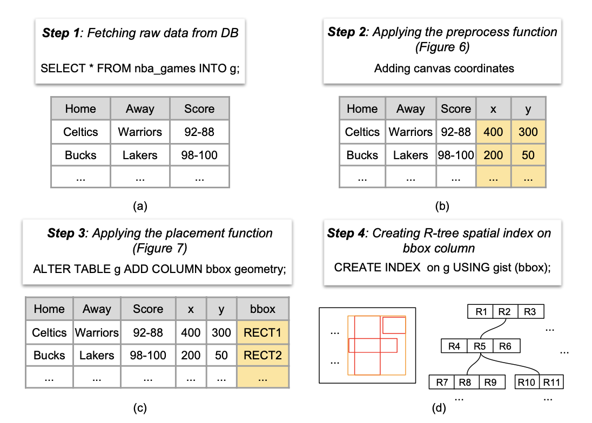
Contributions 3 – Performance Optimization
Issue: Memory size
Sol:
precomputed on disk R tree.
To fetch data inside a given viewport, the backend can issue a spatial query that returns all records whose bounding boxes intersect with the viewport.
Notes:
Minimum bounf rectangle
Here is an example of offline indexing..
When To fetch data inside a given viewport, the backend can issue a spatial query that returns all records whose bounding boxes inter- sect with the viewport.

Slide 53
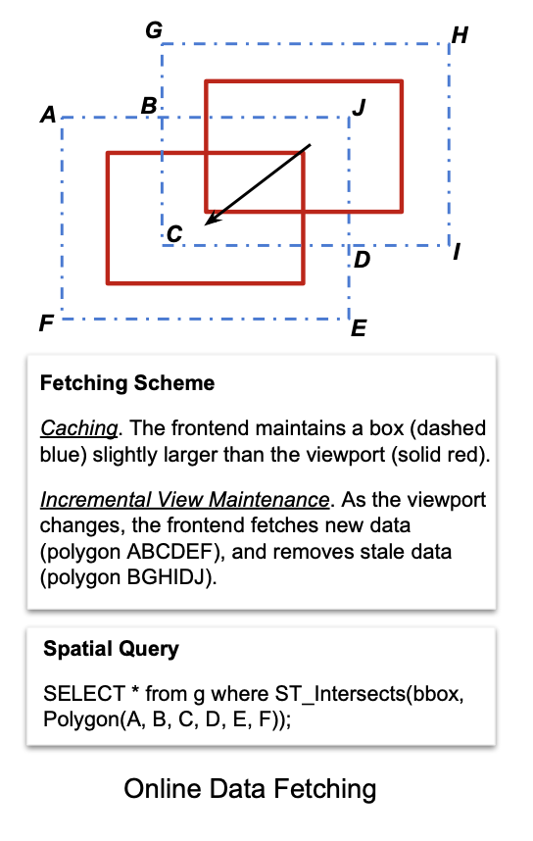
Contributions 3 – Performance Optimization
Issue:CPU, bandwidth
Sol:
Caching and Incremental View Maintenance
Notes:
Minimum bounf rectangle
Here is an example of offline indexing..

Slide 54
Evaluation/Experiments
Developer Study
Performance Study
Scalability
Effect of caching and Incremental View Maintenance
Performance on task – demonstrate real time support
Motivation is for general purposes
Get rid of comparing with google map…
But good to know…

Slide 55
Biased Opinion
Generality
Optimized procedure for specific tasks?
Ease of Use
Code?
User’s finishing time, 17mins, 24min.

